Slide 1
Data Structures CS-2001 Week#3
Lecture 7,8 and 9

Slide 2

Memory representation

Slide 3
Introduction:
A data structure is a logical representation of data and operation that can be performed on the data.
Linear data structure
Non linear data structure
Linear data structure is an order of data elements. They are arrays, stacks, queues, and linked lists.

Slide 4

Linked list
Linked list is a linear data structure. It contains nodes. Each node contains two parts,
i.e. DATA part and LINK part.
The data contains elements and Link contains address of another node.

Slide 5
Limitations Of Arrays
Arrays are simple to understand and elements of an array are easily accessible
But arrays have some limitations.
Arrays have a fixed dimension.
Once the size of an array is decided it can not be increased or decreased during execution.
Array elements are always stored in contiguous memory locations.
Operations like insertion or deletion of the array are pretty tedious.
To over come this limitations we use linked list.
Notes:
Why Linked List? Arrays can be used to store linear data of similar types, but arrays have the following limitations. 1) The size of the arrays is fixed: So we must know the upper limit on the number of elements in advance. Also, generally, the allocated memory is equal to the upper limit irrespective of the usage. 2) Inserting a new element in an array of elements is expensive because the room has to be created for the new elements and to create room existing elements have to be shifted.
For example, in a system, if we maintain a sorted list of IDs in an array id[].
id[] = [1000, 1010, 1050, 2000, 2040].
And if we want to insert a new ID 1005, then to maintain the sorted order, we have to move all the elements after 1000 (excluding 1000). Deletion is also expensive with arrays until unless some special techniques are used. For example, to delete 1010 in id[], everything after 1010 has to be moved.

Slide 6
Types Of Linked Lists
Single linked list
Double linked list
Circular linked list
Circular double linked list

Slide 7
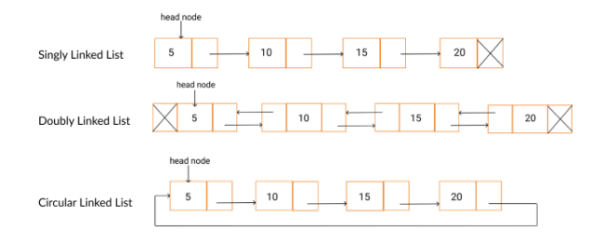
Types Of Linked Lists

Slide 8
Single linked list
A single linked list is one in which all nodes are linked together in some sequential manner.
Operations on Single Linked List
The following operations are performed on a Single Linked List
Insertion
Deletion
Display

Slide 9
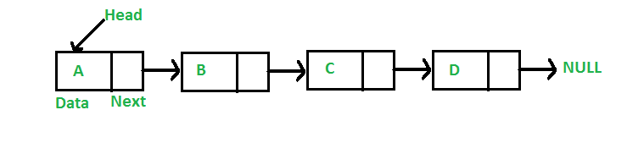
Representation Of Linked List
A linked list is represented by a pointer to the first node of the linked list.
The first node is called the head. If the linked list is empty, then the value of the head is NULL.
Each node in a list consists of at least two parts:
Data
Pointer (Or Reference) to the next node

Slide 10


Representation Of Linked List
In C, we can represent a node using structures. Below is an example of a linked list node with integer data.
In Java or C# or C++, LinkedList can be represented as a class and a Node as a separate class. The LinkedList class contains a reference of Node class type.

